Slide 1
Analysis of Salaries in
San Francisco
By
Gaurav Kshirsagar
Ajinkya Ingle
Under Guidance of
Distinguished Prof. Amirhossein Gandomi

Slide 2
Introduction
One of the ways to observe how city government works is to look at how they employ people and compensate them.
Studying a dataset of salaries demonstrates some really interesting patterns about the city’s employment
San-Francisco county has approx $430 billion as their GDP which is greater than several countries.
The distribution of this capital gives us the insights of how a metropolitan city manages its workforce.

Slide 3
Objective
To predict whether the employee is male or female based on the different sections of their salaries data and the type of Job they are doing.
The classification techniques used are K Nearest Neighbour(KNN) and Logistic Regression.
Based on the output of the algorithms the one with the highest accuracy is recommended

Slide 4
Exploratory Data Analysis
We had a dataset of 148,650 entries of people of different professions from the city of san francisco.
The number of variables were 12 for each entry
There are some variables with character which we converted to numerical values.
The data cleaning was performed to omit or modify the fields with “Not provided” status or “NA” fields.

Slide 5
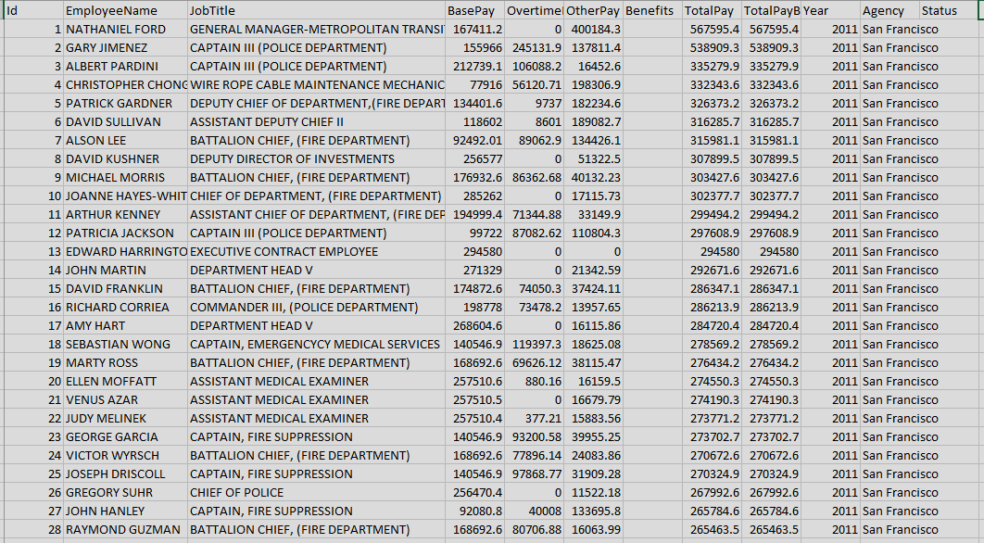
Exploratory Data Analysis

Slide 6
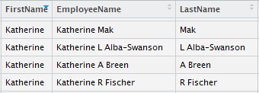

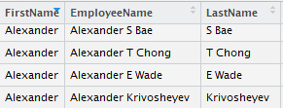

Cleaning and Random Sampling
We have used the name of Employee’s to differentiate them as Male or Female.

Slide 7
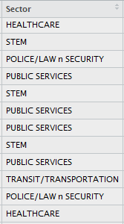
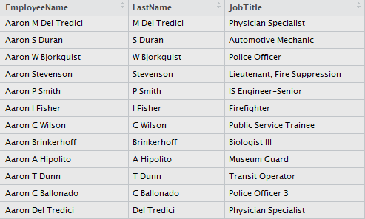
Cleaning and Random Sampling
Here the Jobs are categorized into their sectors.

Slide 8
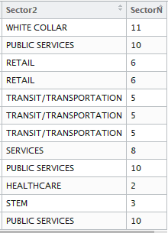
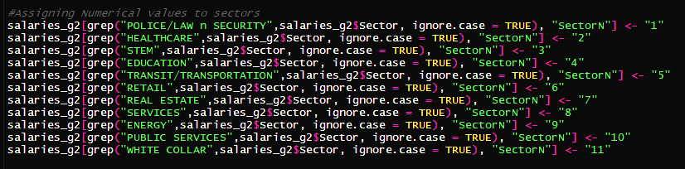
Cleaning and Random Sampling
Here we have assigned numeric values to the sectors, so they can be used in further processing.

Slide 9
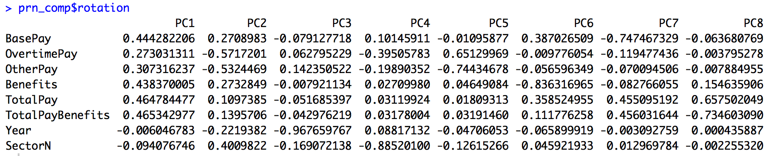
Dimension Reduction using PCA
After using ‘prcomp’ method for Principal Component Analysis using the ‘training1’ dataframe we get following results.
The greatest values are the once that denote the most deciding factor among all the attributes.

Slide 10
Dimension Reduction using PCA
We take a look at Eigen values to decide the number of PC’s
We consider first 5 values since they seems to be the deciding factors.
We calculate proportion of variance and get the following results
And to get a clear picture we calculate the cumulative variance
The first 5 components explain the 98% data which is quite significant.

Slide 11
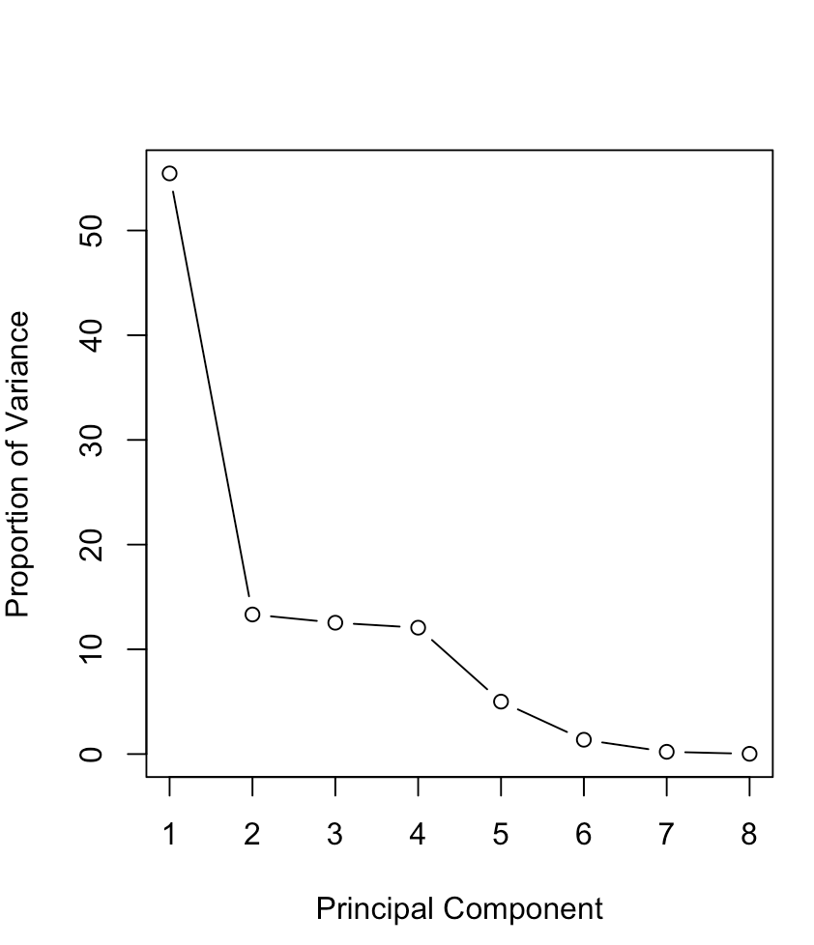
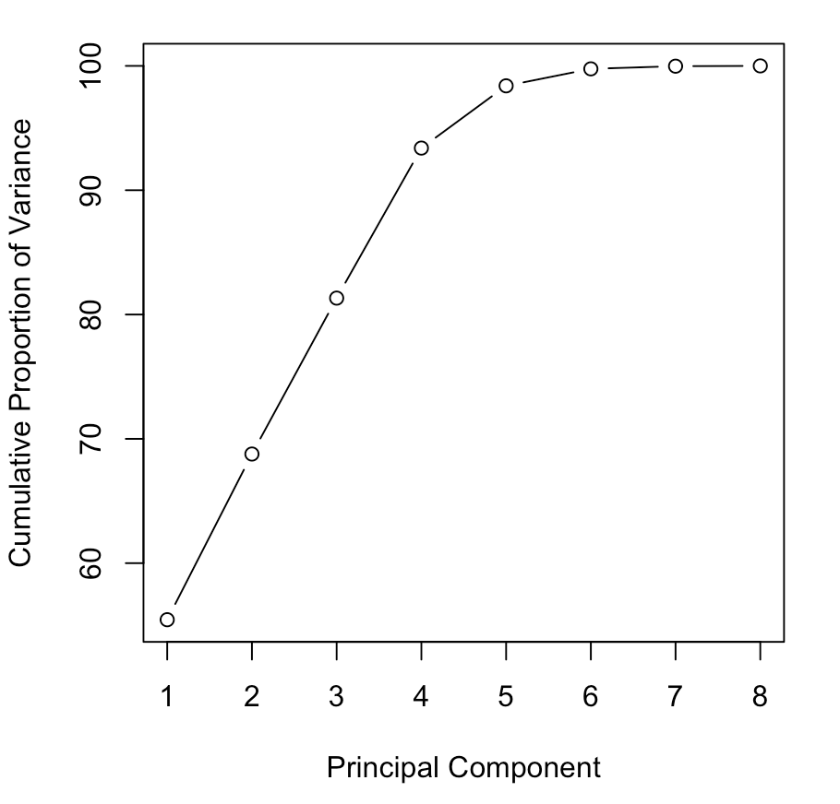
Dimension Reduction using PCA
Scree Plot of Proportion of Variance.
Scree Plot of Proportion of Variance(Cumulative).

Slide 12
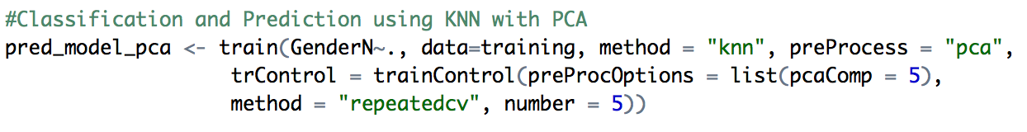
Classification by KNN
“caret” library of R was used to apply KNN classification
The number of PC’s were mentioned to be 5
We used ‘repeatedcv’ method to improve on accuracy.

Slide 13
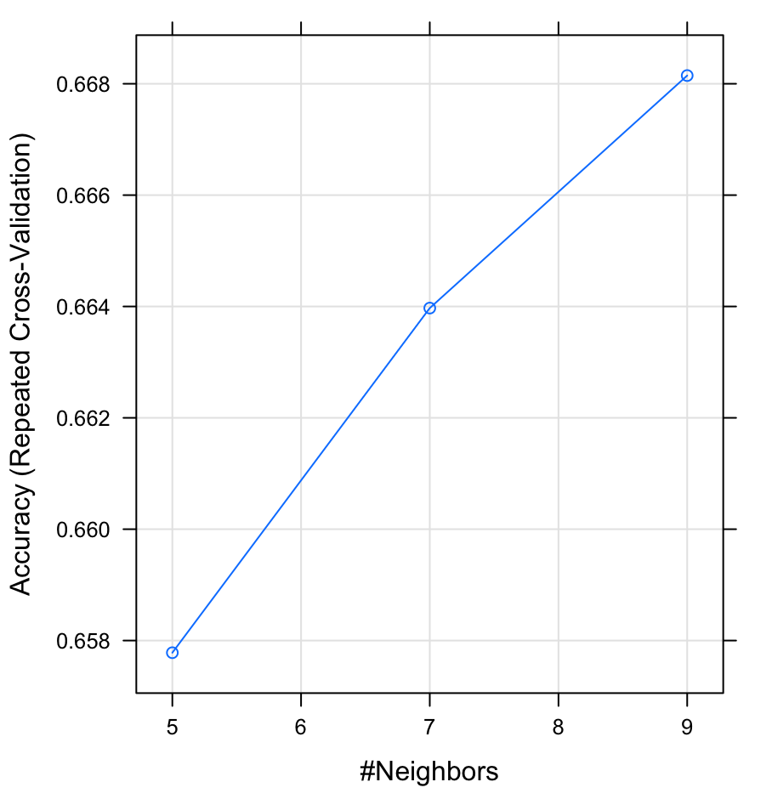
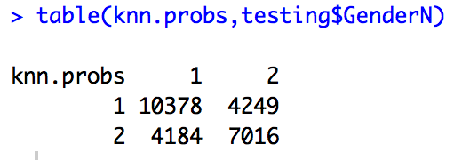
KNN Output
Confusion matrix of KNN
Accuracy = ((10378+7016)/25827)*100 = 67.34 %

Slide 14
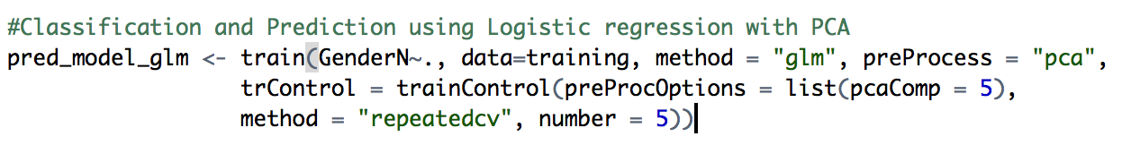
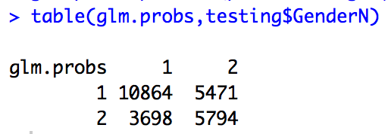
Logistic regression
Second method we used for classification was Logistic Regression
The confusion matrix of Logistic Regression

Slide 15
Comparing Accuracy’s
Confusion matrix of KNN
Accuracy = ((10378+7016)/25827)*100 = 67.34 %
Confusion matrix of LR
Accuracy = ((10864+5794/25827)*100 = 64.49 %

Slide 16
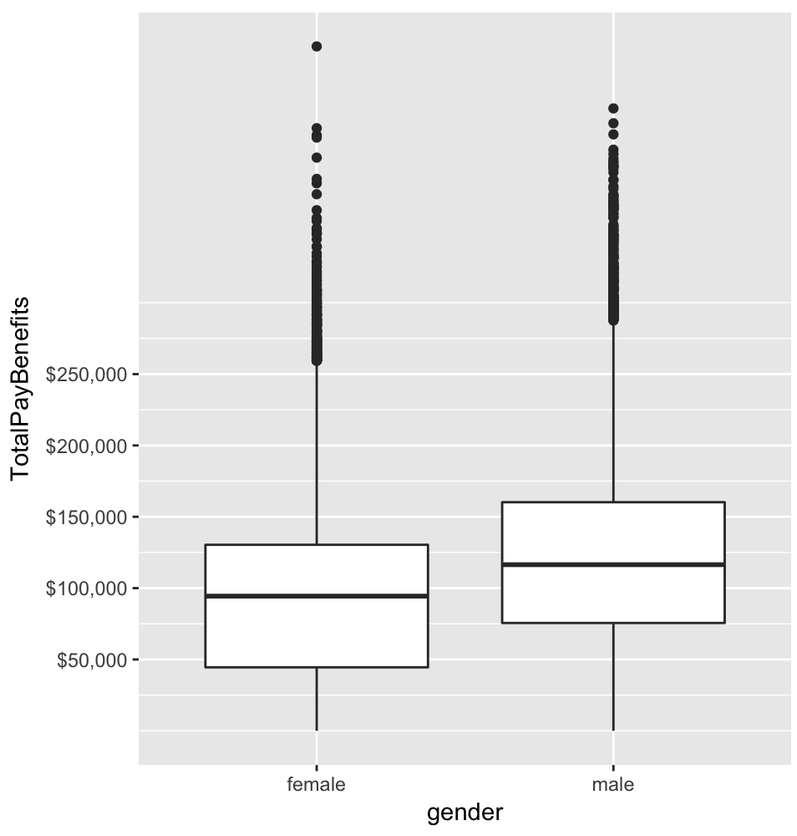
Gender Box plot
Box plot representing the distribution of salaries between males and females.
Males earn significantly higher salaries in all 4 quartiles.
Females have more outliers than men

Slide 17
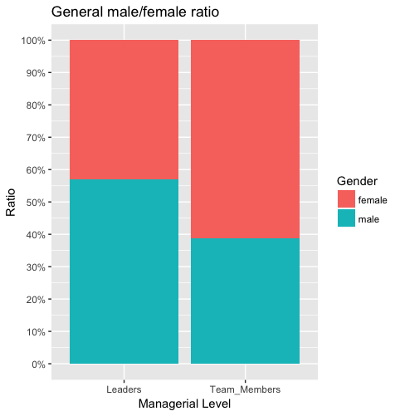
Distribution of Managerial Jobs
There are more leaders in male population of the workforce.
Whereas, more females are observed in the “Team members” category.
This demonstrates uneven distribution of leadership roles in the city.

Slide 18
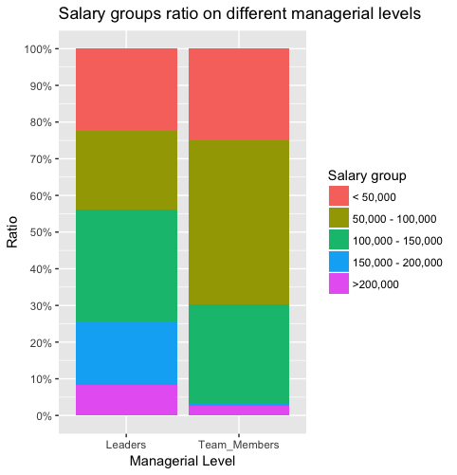
Distribution of Managerial Jobs
Managers are paid considerably higher
Most workers lie in 50k-100k category
Most managers earn between 100k-150k or more.

Slide 19
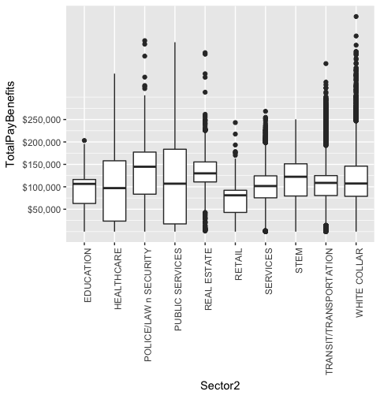
Sector box plot
As the name suggests “White Collar” jobs are the highest paying jobs.
“Public Services” people have more stable distribution.
“Real Estate” people have most diverse distribution.
Most “Retail” sector jobs are under 100k.

Slide 20


Word Cloud
Top 80% quartile of Total income
Bottom 20% quartile of Total income

Slide 21
Thank You !!

